Slide 1
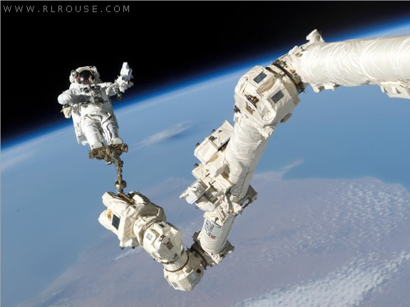
NMT EE 589 & UNM ME 482/582
Robot Engineering
Dr. Stephen Bruder
NMT EE 589 & UNM ME 482/582
Notes:
Presentation slide for courses, classes, lectures et al.

Slide 2
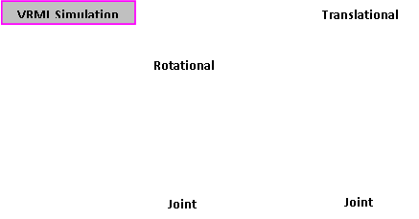
Robot Kinematics
Kinematics is the science of motion without regard to the forces giving rise to the motion.
Due to mechanical considerations manipulators are generally constructed with joints exhibiting only one degree of freedom each. Typically, these are rotational or translational.
VRML Simulation

Slide 3
3.1 Forward Kinematics
To solve the forward kinematics problem we would like to attach a virtual coordinate system to each and every link of the manipulator.
For reference purposes we may also place frames on the robot's stationary base and out at the gripper (or tool-tip).
Recalling that an arbitrarily located coordinate frame requires 6-parameters to uniquely describe its pose, it seems counter-intuitive that we will now proceed to use only 4-parameters (the justification for this will follow).
There exist many approaches to this problem, however, herein we will employ the so-called modified Denavit-Hartenburg approach.
NOTE: Be careful as some other textbooks use the standard Denavit-Hartenburg notation!!!

Slide 4
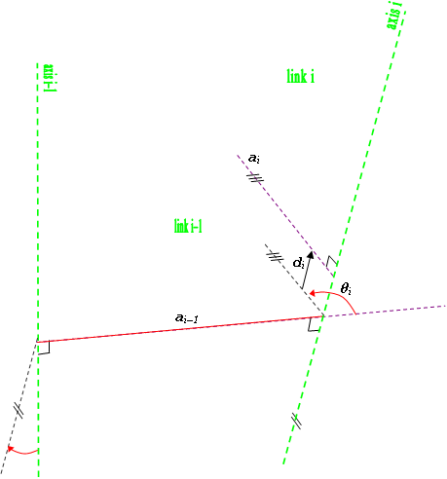
3.1 Forward Kinematics
The following figure illustrates the four D-H parameters:
axis i
axis i-1
link offset
Joint angle
link length
link twist

Slide 5


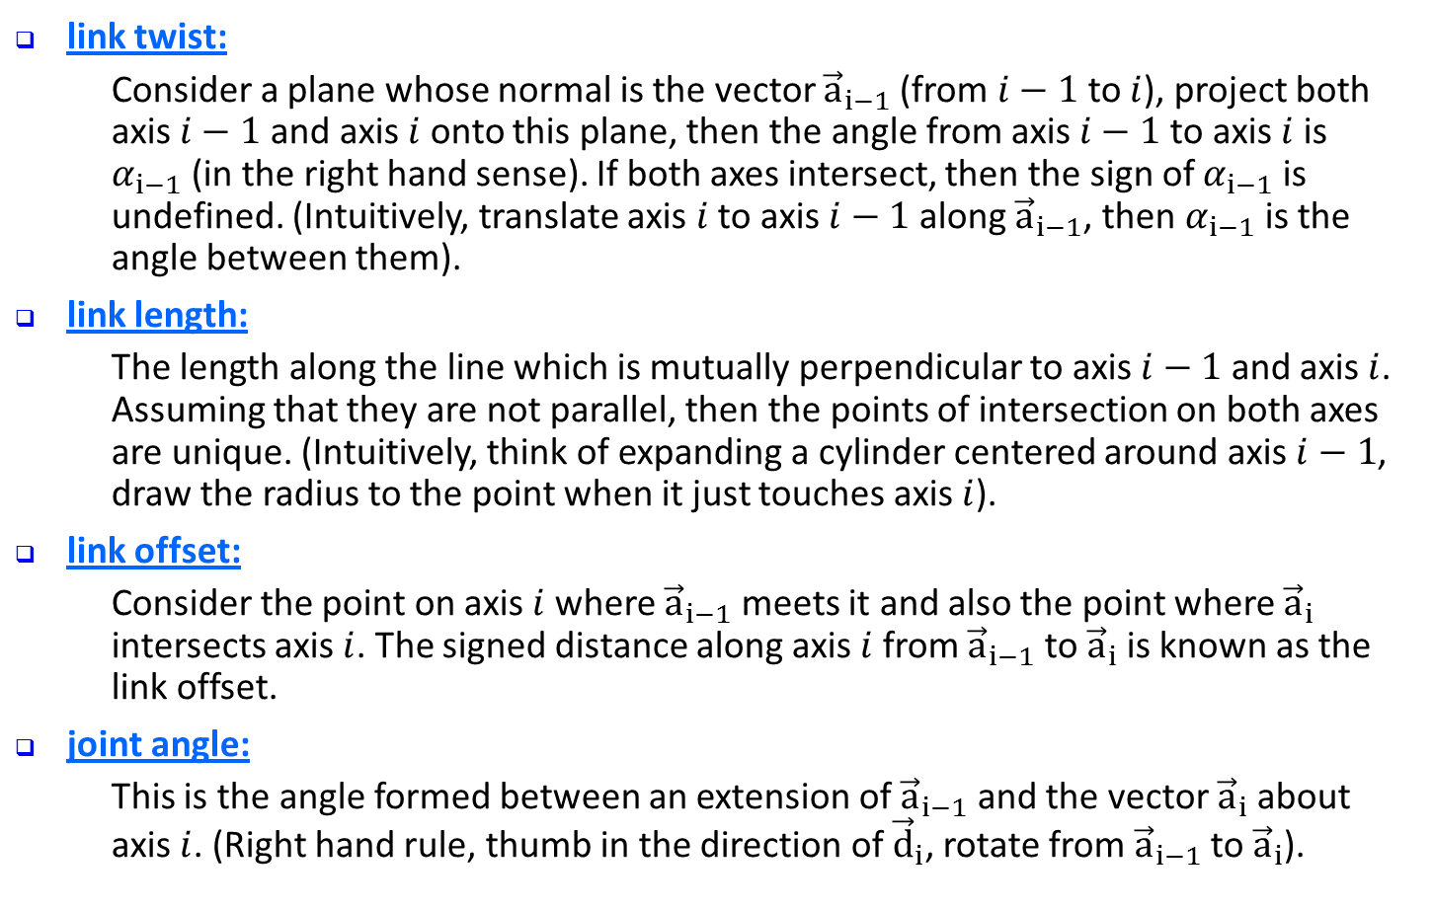
3.1 Forward Kinematics
link twist:
    Consider a plane whose normal is the vector ${\vec{a}}_{i−1}$(from $i−1$ to $i$), project both axis $i−1$ and axis $i$ onto this plane, then the angle from axis $i−1$ to axis $i$ is $α_{i−1}$(in the right hand sense). If both axes intersect, then the sign of $α_{i−1}$ is undefined. (Intuitively, translate axis $i$ to axis $i−1$ along ${\vec{a}}_{i−1}$, then $α_{i−1}$ is the angle between them).
link length:
    The length along the line which is mutually perpendicular to axis $i−1$ and axis $i$. Assuming that they are not parallel, then the points of intersection on both axes are unique. (Intuitively, think of expanding a cylinder centered around axis $i−1$, draw the radius to the point when it just touches axis $i$).
link offset:
    Consider the point on axis $i$ where ${\vec{a}}_{i−1}$ meets it and also the point where ${\vec{a}}_{i}$ intersects axis $i$. The signed distance along axis $i$ from ${\vec{a}}_{i−1}$ to ${\vec{a}}_{i}$ is known as the link offset.
joint angle:
    This is the angle formed between an extension of ${\vec{a}}_{i−1}$ and the vector ${\vec{a}}_{i}$ about axis $i$. (Right hand rule, thumb in the direction of ${\vec{d}}_{i}$, rotate from ${\vec{a}}_{i−1}$ to ${\vec{a}}_{i}$).
If the link is prismatic then $d_{i}$ is the joint variable
If the link is revolute then $θ_{i}$ is the joint variable

Slide 6
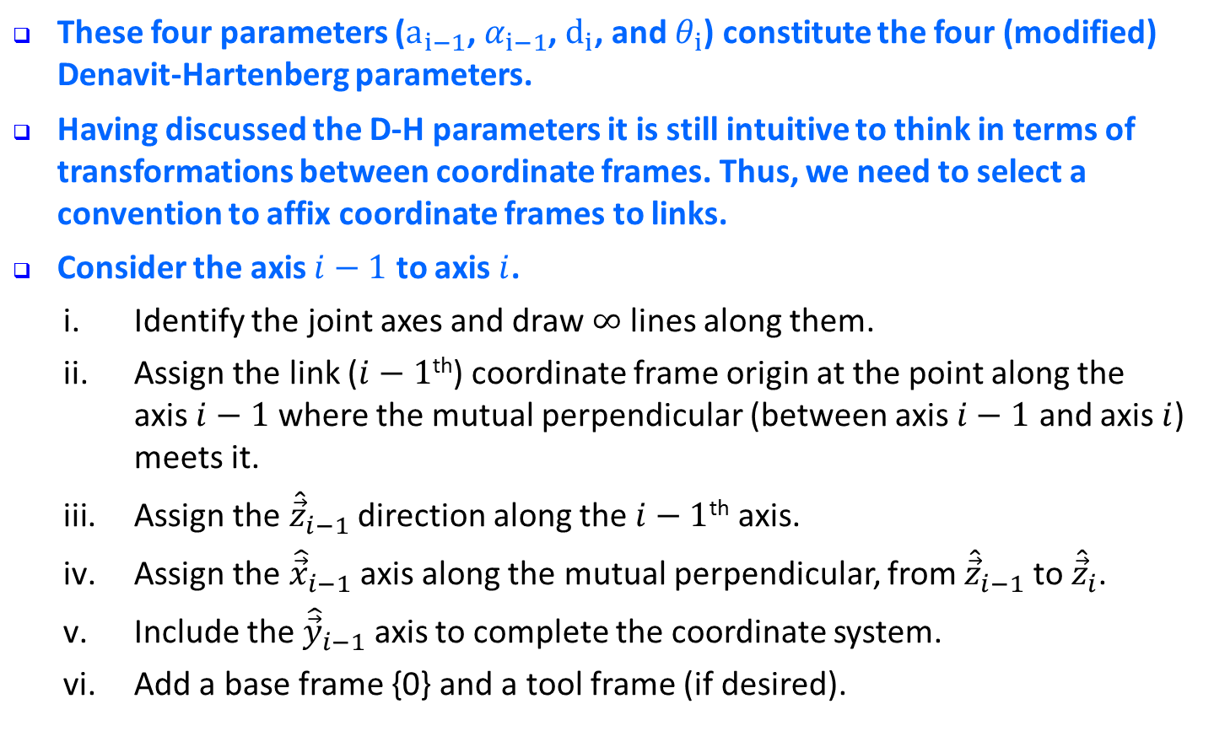
3.1 Forward Kinematics
These four parameters ($a_{i−1}$, $α_{i−1}$, $d_{i}$, and $θ_{i}$) constitute the four (modified) Denavit-Hartenberg parameters.
Having discussed the D-H parameters it is still intuitive to think in terms of transformations between coordinate frames. Thus, we need to select a convention to affix coordinate frames to links.
Consider the axis $i−1$ to axis $i$.
  Identify the joint axes and draw $∞$ lines along them.
  Assign the link ($i−1$^{th}) coordinate frame origin at the point along the
  axis $i−1$ where the mutual perpendicular (between axis $i−1$ and axis $i$) meets it.
  Assign the ${\hat{\vec{z}}}_{i−1}$ direction along the $i−1$^{th} axis.
  Assign the ${\hat{\vec{x}}}_{i−1}$ axis along the mutual perpendicular, from ${\hat{\vec{z}}}_{i−1}$ to ${\hat{\vec{z}}}_{i}$.
  Include the ${\hat{\vec{y}}}_{i−1}$ axis to complete the coordinate system.
  Add a base frame {0} and a tool frame (if desired).

Slide 7

3.1 Forward Kinematics
As a simplifying convention for the first (and last) links, we may wish to assign frame {0} to match frame {1} when the first joint variable is zero (i.e., when $θ_{1}=0$ or $d_{1}=0$).
VRML Simulation
Link i
Link i-1

Slide 8

3.1 Forward Kinematics
We can now construct the homogeneous transformation matrix relating coordinate frames {i–1} and {i}. To describe {i} as seen from {i–1}:
  Rotate about ${\hat{\vec{x}}}_{i−1}$ by $α_{i−1}$.
  Then, translate about ${\hat{\vec{x}}}_{i−1}$ by $a_{i−1}$.
  Next, rotate about the new z-axis (axis i) by $θ_{i}$.
  Finally, translate along the new z-axis (axis i) by $d_{i}.$
Note that these are all relative type transformations!!

Slide 9
3.1 Forward Kinematics
Hence,
(3.1)

Slide 10
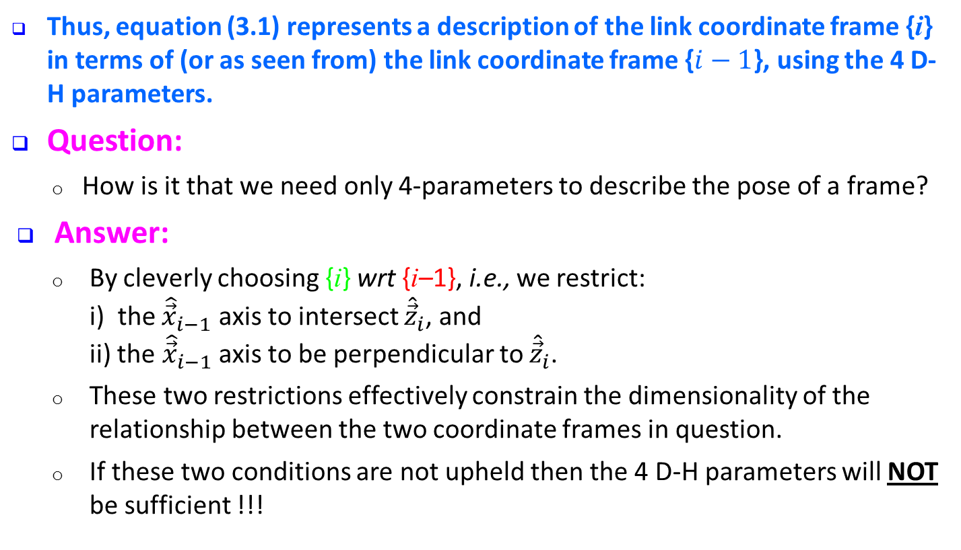
3.1 Forward Kinematics
Thus, equation (3.1) represents a description of the link coordinate frame {i} in terms of (or as seen from) the link coordinate frame {$i−1$}, using the 4 D-H parameters.
Question:
  How is it that we need only 4-parameters to describe the pose of a frame?
Answer:
  By cleverly choosing {i} wrt {i–1}, i.e., we restrict:
  i) the ${\hat{\vec{x}}}_{i−1}$ axis to intersect ${\hat{\vec{z}}}_{i}$, and
  ii) the ${\hat{\vec{x}}}_{i−1}$ axis to be perpendicular to ${\hat{\vec{z}}}_{i}$.
  These two restrictions effectively constrain the dimensionality of the relationship between the two coordinate frames in question.
  If these two conditions are not upheld then the 4 D-H parameters will NOT be sufficient !!!

Slide 11
3.1 Forward Kinematics
Remark:
  Notice that steps 1) and 2) can be interchanged (they commute).
  Similarly, steps 3) and 4) can be interchanged (they commute).
  In general, rotations and translations about the same axis will commute!!

Slide 12
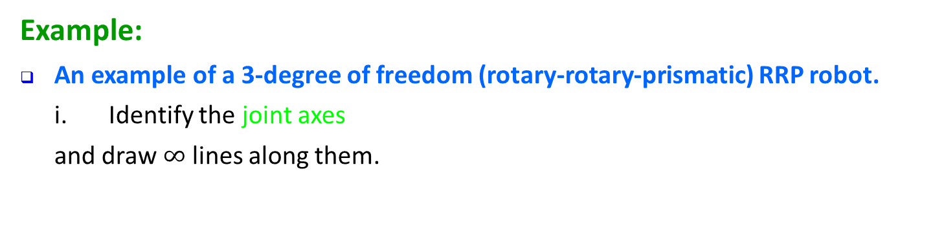
3.1 Forward Kinematics
Example:
An example of a 3-degree of freedom (rotary-rotary-prismatic) RRP robot.
  Identify the joint axes
  and draw $∞$ lines along them.
VRML Simulation
Link# 2
Link# 1
axis 3
axis 2
Link# 3
axis 1
Link# 0

Slide 13
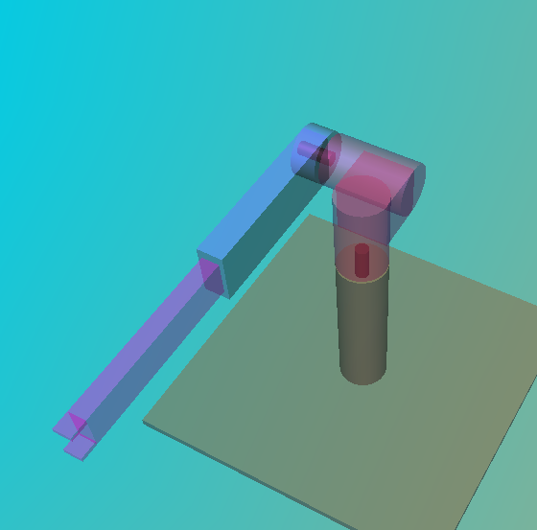

3.1 Forward Kinematics
  Assign the link ($i−1$^{th}) coordinate frame origin at the point along
  the axis $i−1$ where the mutual perpendicular (between axis $i−1$ and axis $i$) meets it.
  Note: Since there is no mutual
  perpendicular between axis 3 and
  axis 4 (non-existent), the origin of
  frame {3} can be placed anywhere
  on axis 3.
origin of frame{2}
mutual perpendicular
betweeen axes 2 and 3
mutual perpendicular
betweeen axes 1 and 2
axis 3
axis 2
origin of frame{1}
origin of frame{3}
axis 1

Slide 14
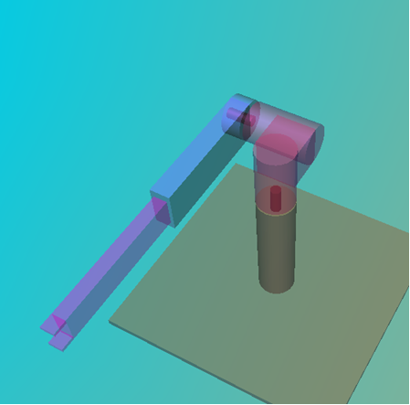

3.1 Forward Kinematics
  Assign the ${\hat{\vec{z}}}_{i−1}$ direction along the $i−1$^{th} axis.
  Note: The direction of z-axis is
  not unique. The negative of what
  we have chosen would work just
  fine!!
z₂
z₁
axis 3
axis 2
z₃
axis 1

Slide 15

3.1 Forward Kinematics
  Assign the ${\hat{\vec{x}}}_{i−1}$ axis along the mutual perpendicular, from ${\hat{\vec{z}}}_{i−1}$ to ${\hat{\vec{z}}}_{i}$.
    For i = 2, ${\hat{\vec{x}}}_{1}$ axis from ${\hat{\vec{z}}}_{1}$ to ${\hat{\vec{z}}}_{2}$
    (unique).
    For i = 3, ${\hat{\vec{x}}}_{2}$ axis from ${\hat{\vec{z}}}_{2}$ to ${\hat{\vec{z}}}_{3}$
    (not unique since axis 2 and
    axis 3 intersect).
    For i = 4, ${\hat{\vec{x}}}_{3}$ axis from ${\hat{\vec{z}}}_{3}$ to ${\hat{\vec{z}}}_{4}$
    (not unique since axis 4 does
    not exist).
x₂
z₂
z₁
x₁
axis 3
axis 2
x₃
z₃
axis 1

Slide 16

3.1 Forward Kinematics
  Include the ${\hat{\vec{y}}}_{i−1}$ axis to complete the coordinate system.
  Recall: Right-hand coordinate system.
  Add a base frame {0} and a
  tool frame (if desired).
VRML Simulation
x₂
y₂
z₂
z₁
y₁
x₁
axis 3
axis 2
x₃
  Note: Must adhere to the
  two D-H constraints when
  choosing frames {0} & {4}!
y₃
z₃
axis 1
y₀
z₀
x₀
x₄
y₄
z₄

Slide 17
3.1 Forward Kinematics
Rules to determine the four D-H parameters:
Before starting, be sure that for each frame the x-axis points to and is perpendicular to the next z-axis:
  This allow us to use only 4-parameters
  Otherwise DH constraints will NOT be upheld

Slide 18

3.1 Forward Kinematics
Link #1 (From frame {0} to frame {1} : i=1)
  Link Twist ($α_{i−1}$):
    Rotate about ${\hat{\vec{x}}}_{0}$ by $α_{0}$ resulting in the z-axis becoming parallel with the next z-axis.
  Link Length ($a_{i−1}$):
    Translate along ${\hat{\vec{x}}}_{0}$ by $a_{0}$.
    This will result in the current
    z-axis becoming collinear with the
    next z-axis.
  Link Offset ($d_{i}$):
    Translate along z-axis by $d_{1}$.
    This will result in the coordinate frame
    origins becoming coincident.
  Joint Angle ($θ_{i}$):
    Rotate about z-axis by $θ_{1}$.
    This final step should result in frame
    $\{0\}$ coinciding with frame {1}.
x₂
y₂
z₂
d₁
z₁
y₁
x₁
axis 3
axis 2
x₃
y₃
axis 1
z₃
z₀
x₀
y₀
x₄
y₄
θ₁(t)
z₄

Slide 19

3.1 Forward Kinematics
Link #2 (From frame {1} to frame {2} : i=2)
  Link Twist ($α_{i−1}$):
    Rotate about ${\hat{\vec{x}}}_{1}$ by $α_{1}$ resulting in the z-axis becoming parallel with the next z-axis.
  Link Length ($a_{i−1}$):
    Translate along ${\hat{\vec{x}}}_{1}$ by $a_{1}$.
    This will result in the current
    z-axis becoming collinear with the
    next z-axis.
  Link Offset ($d_{i}$):
    Translate along z-axis by $d_{2}$.
    This will result in the coordinate frame
    origins becoming coincident.
  Joint Angle ($θ_{i}$):
    Rotate about z-axis by $θ_{2}$.
    This final step should result in frame
    $\{1\}$ coinciding with frame {2}.
d₂
θ₂(t)
x₂
y₂
z₂
z₁
y₁
x₁
axis 3
a₁
axis 2
x₃
y₃
axis 1
z₃
z₀
x₀
y₀
x₄
y₄
z₄

Slide 20

3.1 Forward Kinematics
Link #3 (From frame {2} to frame {3} : i=3)
  Link Twist ($α_{i−1}$):
    Rotate about ${\hat{\vec{x}}}_{2}$ by $α_{2}$ resulting in the z-axis becoming parallel with the next z-axis.
  Link Length ($a_{i−1}$):
    Translate along ${\hat{\vec{x}}}_{2}$ by $a_{2}$.
    This will result in the current
    z-axis becoming collinear with the
    next z-axis.
  Link Offset ($d_{i}$):
    Translate along z-axis by $d_{3}$.
    This will result in the coordinate frame
    origins becoming coincident.
  Joint Angle ($θ_{i}$):
    Rotate about z-axis by $θ_{3}$.
    This final step should result in frame
    $\{2\}$ coinciding with frame {3}.
x₂
y₂
z₂
z₁
y₁
x₁
axis 3
axis 2
x₃
y₃
d₃(t)
axis 1
z₃
z₀
x₀
y₀
x₄
y₄
z₄

Slide 21

3.1 Forward Kinematics
NOTE: There is NO link 4. Both frames {3} & {4} are attached to link 3
Link #4 (From frame {3} to frame {4} : i=4)
  Link Twist ($α_{i−1}$):
    Rotate about ${\hat{\vec{x}}}_{3}$ by $α_{3}$ resulting in the z-axis becoming parallel with the next z-axis.
  Link Length ($a_{i−1}$):
    Translate along ${\hat{\vec{x}}}_{3}$ by $a_{3}$.
    This will result in the current
    z-axis becoming collinear with the
    next z-axis.
  Link Offset ($d_{i}$):
    Translate along z-axis by $d_{4}$.
    This will result in the coordinate frame
    origins becoming coincident.
  Joint Angle ($θ_{i}$):
    Rotate about z-axis by $θ_{4}$.
    This final step should result in frame
    $\{3\}$ coinciding with frame {4}.
x₂
y₂
z₂
z₁
y₁
x₁
axis 3
axis 2
x₃
y₃
d₄
axis 1
z₃
z₀
x₀
y₀
x₄
y₄
z₄
NOTE: There is NO 4th joint variable

Slide 22
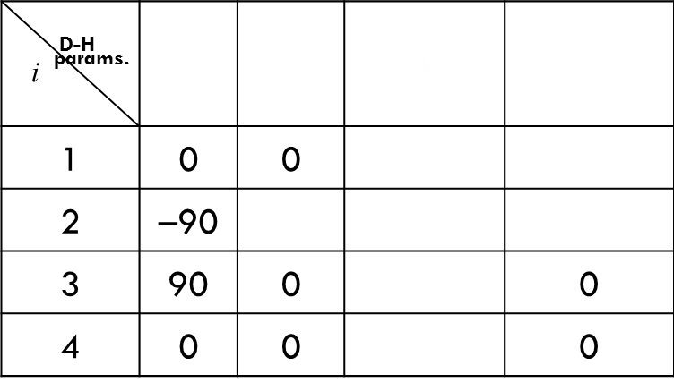
3.1 Forward Kinematics
NOTE: Do this one link at a time (i.e. pair of coord frames)
  All of the above are relative transformations.
  Either the third or fourth parameter will be the joint variable.
VRML Simulation
d₂
θ₂(t)
D-H params. i |  |  | $${\text{d}}_{\text{i}}$$
1 | 0 | 0
2 | –90
3 | 90 | 0 |  | 0
4 | 0 | 0 |  | 0
x₂
y₂
z₂
d₁
z₁
y₁
x₁
axis 3
a₁
axis 2
x₃
y₃
d₄
d₃(t)
axis 1
z₃
z₀
x₀
y₀
x₄
y₄
Next, generate the “T-matrices”
Courtesy of Mathematica
θ₁(t)
z₄

Slide 23
3.1 Forward Kinematics
Let us now use the D-H parameters from the link table to construct the homogeneous matrices which will relate one link coordinate frame to the next.

Slide 24

3.1 Forward Kinematics
Therefore, we can now compute the coordinates of the gripper (frame {4}) as seen from the base or reference frame (frame {0}), in terms of the 3 joint variables ($θ_{1},θ_{2},$ $d_{3}$).
(3.2)

