Slide 1
NMT EE 589 & UNM ME 482/582 Robot Engineering
Dr. Stephen Bruder NMT EE 589 & UNM ME 482/582
Notes:
Presentation slide for courses, classes, lectures et al.

Slide 2
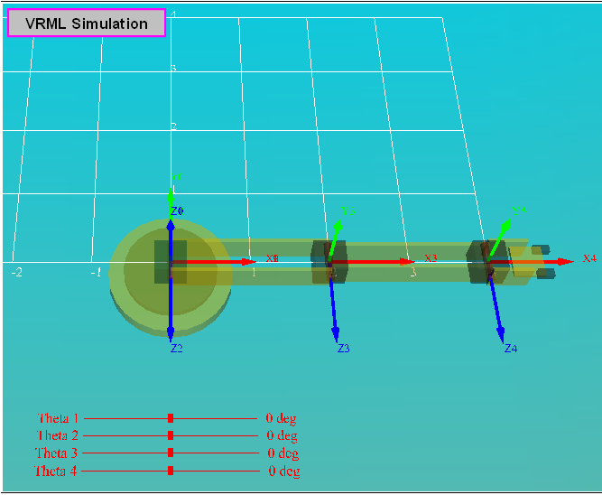
3.3 Simplifying the Starting Equations
Example:
The LynxMotion Lynx 5 Satellite Arm
VRML Simulation

Slide 3
3.3 Simplifying the Starting Equations
The Denavit-Hartenberg table:
Generate the “T-matrices” courtesy of Mathematica.
D-H params. i |  |  | $${\text{d}}_{\text{i}}$$
1 | 0 | 0 | 0
2 | 90 | 0 | 0
3 | 0 |  | 0
4 | 0 |  | 0

Slide 4
3.3 Simplifying the Starting Equations
Thus, the forward kinematics of this robotic arm can be described by the matrix $\left.{}_{4}^{0}T(θ_{1},θ_{2},θ_{3},θ_{4}\right)$
As this robot has only four independent joints, it will NOT be able to reach an arbitrary 6-dimensional pose (position and orientation). Let’s use this robot to realize a 3-D position and 1-D orientation.
The three scalar positional equations are: (3.26) (3.27) (3.28)

Slide 5
3.3 Simplifying the Starting Equations
For a 1-D orientational constraint it seems reasonable to stipulate the inclination (or declination) angle ($θ_{1}$) of the gripper to the ground plane.
This inclination angle ($θ_{1}$) is the angle that ${\hat{\vec{x}}}_{4}$ makes with a horizontal plane (i.e., $x_{0}\text{−}y_{0}$ plane) or the angle ${\hat{\vec{y}}}_{4}$ makes with a vertical plane, therefore, and
Recalling equation (2.10), we see that
Hence, to define an inclination angle we are effectively choosing the (3, 1) and (3, 2) elements of the desired rotation matrix.

Slide 6
3.3 Simplifying the Starting Equations
Thus, the scalar equations become (3.29) (3.30)
Solving these equations gives (3.31)
By noting that the distance from the origin of frame {0} to the origin of frame {4} should depend only on $θ_{3}$, we get (3.32)

Slide 7
3.3 Simplifying the Starting Equations
Dividing equation (3.27) by equation (3.26) gives (3.33)
Knowing $θ_{1}$, multiply equation (3.27) by ${\text{C}}_{2}$ and add to equation (3.28) multiplied by ${\text{S}}_{2}$ to get (3.34)

Slide 8
3.3 Simplifying the Starting Equations
Multiplying equation (3.26) by ${\text{S}}_{2}$ and subtract from equation (3.28) multiplied by ${\text{C}}_{2}$ gives (3.35)
Equations (3.34) and (3.35) are of the form $\left(\frac{{\text{S}}_{1}}{{\text{C}}_{1}}=\frac{p_{x}}{p_{y}}⇒\frac{p_{x}}{{\text{S}}_{1}}=\frac{p_{y}}{{\text{C}}_{1}}\right)$
Rewriting in matrix/vector form and solving for gives

Slide 9
3.3 Simplifying the Starting Equations
(3.36)
Finally, we can solve for θ₄ as
The resulting set of four solutions can be depicted as a tree rather than a table.

Slide 10
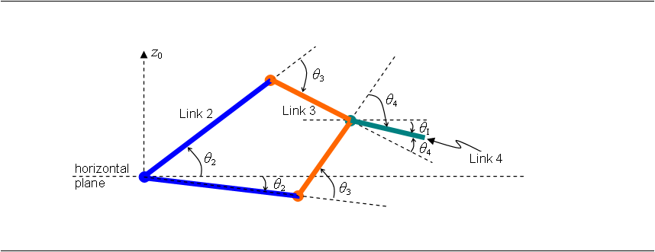
3.3 Simplifying the Starting Equations
The resulting redundancy in the inverse kinematics can be seen by looking at the geometry of the arm (sketched with links 2 and 3 of differing lengths for emphasis).
These two arm configurations are commonly referred to as the “elbow-up” and “elbow-down” configurations.

Slide 11
3.3 Simplifying the Starting Equations
Test the four inverse kinematic solutions:
Choosing $p_{x}=3$, $p_{y}=2$, $p_{z}=0.5$, and $θ_{I}={30}^{∘}$ gives
 | Inverse Kinematics Solution Set
Solution 1
Solution 2
Solution 3
Solution 4
Check these solns visually:

Slide 12
3.3 Simplifying the Starting Equations
Entering these four sets of values for the joint variables back into the forward kinematic equations gives
Solution 1:
Solution 2:

Slide 13
3.3 Simplifying the Starting Equations
Solution 3:
Solution 4:

Slide 14
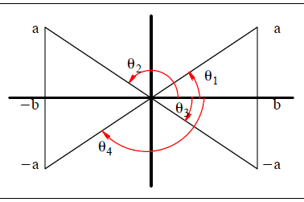
3.3 Simplifying the Starting Equations
A quick trigonometric review of 4-quadrant angles:
See Handout: “inv_kin_table.pdf”

Slide 15
3.3 Simplifying the Starting Equations
Eight Potential Trigonometric CASES:
CASE 1:
Given only, ($b$ known) (i.e., $±θ$)

Slide 16
3.3 Simplifying the Starting Equations
CASE 2:
Given only, ($a$ known) (i.e., $θ$ and ($180−θ$))
CASE 3:
Given, and

Slide 17
3.3 Simplifying the Starting Equations
CASE 4:
Given, (i.e., $θ$ and ($180±θ$))

Slide 18
3.3 Simplifying the Starting Equations
CASE 5:
Given only, $\left(|a|,|b|≤1;φ≠k\text{π}\text{)}\right.$ (i.e., CASE 4) (i.e., $θ$ and ($180±θ$))
Then, we could solve for $φ$ using CASE 2.

Slide 19
3.3 Simplifying the Starting Equations
CASE 6:
Given, $\left(|a|,|b|,|c|≤1\text{)}\right.$
From CASE 5 we know that
when $θ=\tan^{−1}\left(\frac{a}{b}\right) ⇒ sin(θ)=\frac{a}{\sqrt{a^{2}+b^{2}}}$ , hence $sin(φ)=\sqrt{a^{2}+b^{2}}$
when $θ=\tan^{−1}\left(\frac{−a}{−b}\right) ⇒ sin(θ)=\frac{−a}{\sqrt{a^{2}+b^{2}}}$ , hence $sin\left(φ\right)=−\sqrt{a^{2}+b^{2}}$
Hence the two solution pairs are $\left(θ,φ\right)$ and $\left((θ±180),−φ\right)$!!

Slide 20
3.3 Simplifying the Starting Equations
CASE 7:
Given only,
let $a=rcos(γ)$ and $b=rsin(γ)$ , where $r=\sqrt{a^{2}+b^{2}}$ and ${γ=tan}^{−1}\left(\frac{b}{a}\right)$. This is by choice, assuming that $a≠0$ and $b≠0$.
From CASE 2 we can see that (i.e., $\left(γ+\tilde{θ}\right)$ and $\left(γ−\tilde{θ}\right)$)

Slide 21
3.3 Simplifying the Starting Equations
CASE 8:
Given,
Also note that squaring both equations and adding gives: $a^{2}+b^{2}=c^{2}+d^{2}$.

