Slide 1

NMT EE 589 & UNM ME 482/582
Robot Engineering
Dr. Stephen Bruder
NMT EE 589 & UNM ME 482/582
Notes:
Presentation slide for courses, classes, lectures et al.

Slide 2

8.3 Independent Joint Control
Simplified drive train model of a robot joint
  Inertia “seen” by the motor
  Torque amplification
    For “high” gear ration the link
    inertia effect is relatively “small”
The motor can be modeled as
  where B is viscous friction, K_{a} the scale factor from motor voltage (u) to current, and K_{m} the torque constant
Link k
Load
Inertia
Motor
Motor
Inertia
$$\frac{{K_{m}K}_{a}}{I_{k}s+B}$$
U(s)
Ω(s)

Slide 3
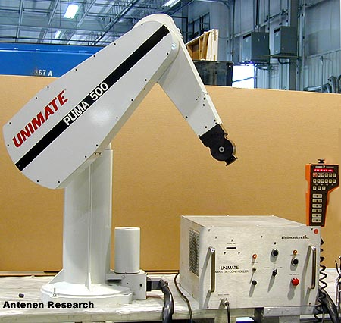
8.3 Independent Joint Control
An example of independent joint control:
  Consider the PUMA 560 robot
  Video: Puma 560 - Gravity Compensation Open Loop

Slide 4
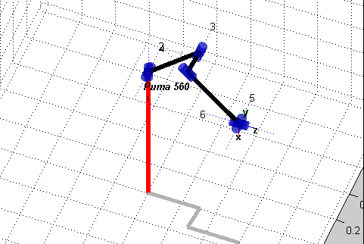
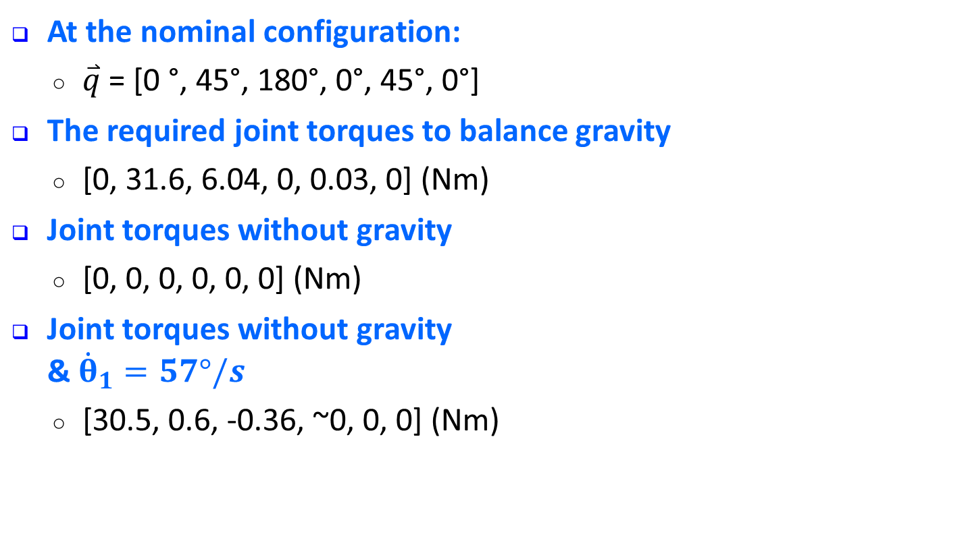
8.3 Independent Joint Control
At the nominal configuration:
  $\overset{⃑}{q}$ = [0 °, 45°, 180°, 0°, 45°, 0°]
The required joint torques to balance gravity
  [0, 31.6, 6.04, 0, 0.03, 0] (Nm)
Joint torques without gravity
  [0, 0, 0, 0, 0, 0] (Nm)
Joint torques without gravity
& ${\dot{θ}}_{1}=57°/s$
  [30.5, 0.6, -0.36, ~0, 0, 0] (Nm)
Viscous
Friction
Coriolis &
Centripetal

Slide 5
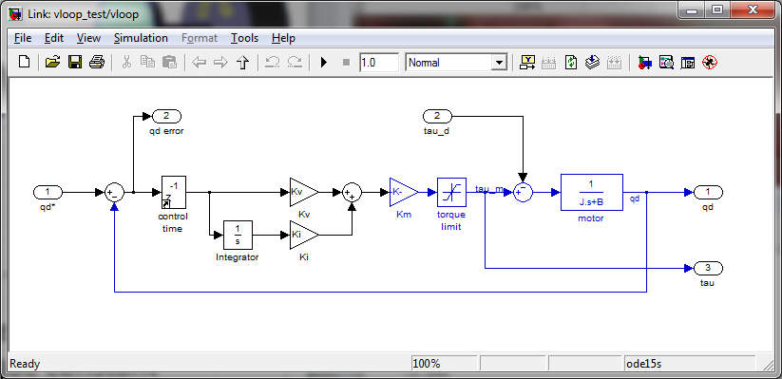
8.3 Independent Joint Control
A simple position control example (Puma 560 the 2nd link)
  Approximate the inertia seen by the motor
    G₂=107, I_{m2}=2X10⁻⁴, D₂₂≈2, hence, J=3.7X10⁻⁴
Outer Position Loop
Inner Velocity Loop

Slide 6
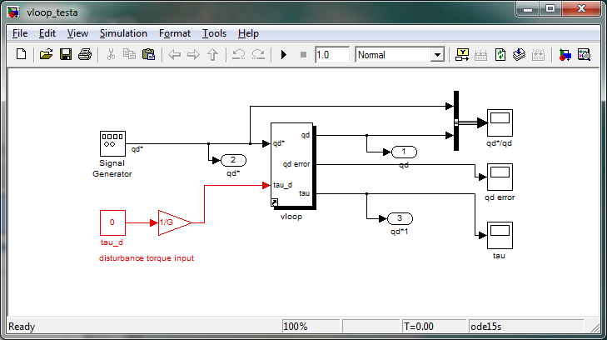
8.3 Independent Joint Control
Speed Control Example
  K_{v}=1.5, 0.5, 1.0
K_{v}=1.0 gives a reasonable system response

Slide 7
8.3 Independent Joint Control
Speed Control Example
  What about the effect of gravity?
    Varies with configuration! (-40 < G₂ < 40)
Let’s add a gravity induced
disturbance torque of 20 Nm

Slide 8
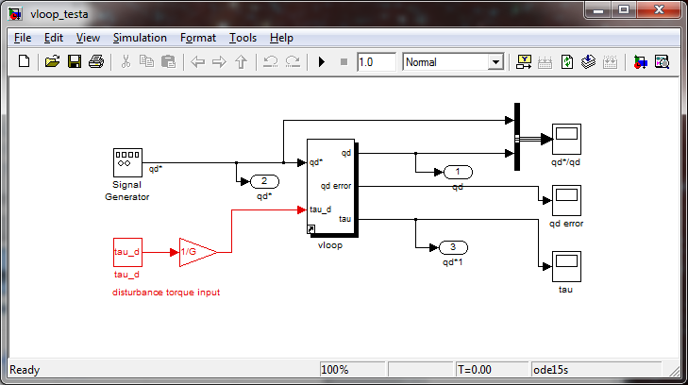
8.3 Independent Joint Control
Add a 20 Nm gravity induced disturbance
    Needs some integral control!!
Disturbance Rejection!!
Massive (1 rad/s) steady state error!!
Ki=10 => No steady state error!!
20 Nm

Slide 9
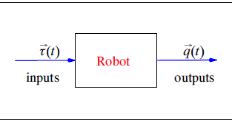
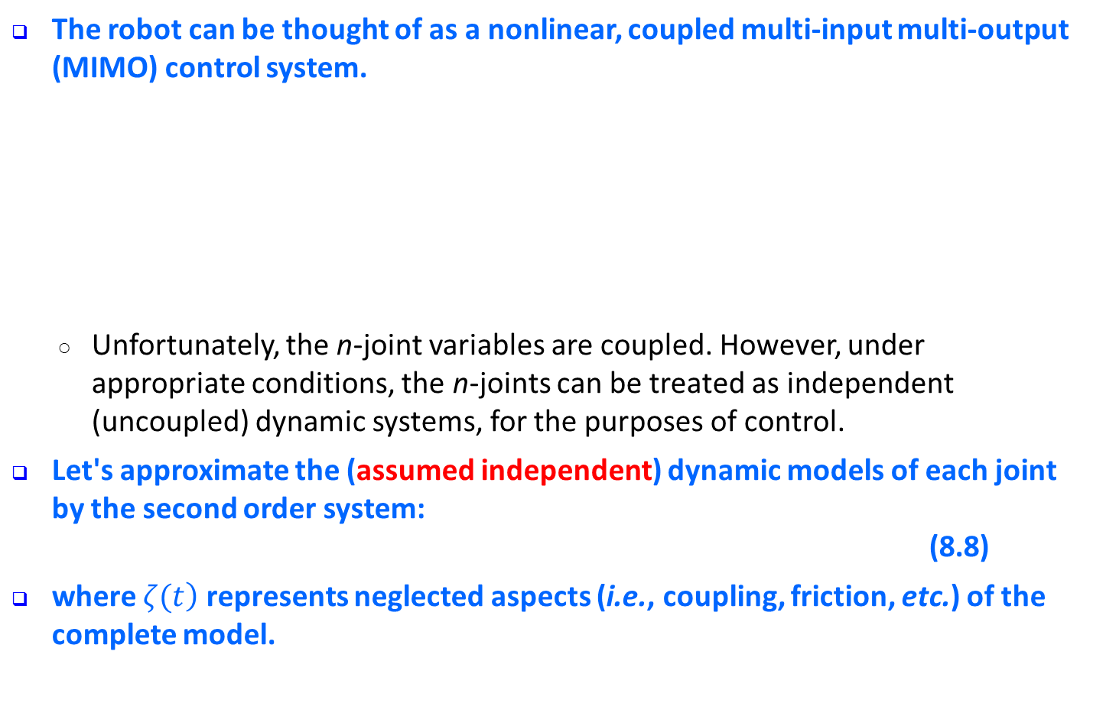
8.3 Independent Joint Control
The robot can be thought of as a nonlinear, coupled multi-input multi-output (MIMO) control system.
  Unfortunately, the n-joint variables are coupled. However, under appropriate conditions, the n-joints can be treated as independent (uncoupled) dynamic sys­tems, for the purposes of control.
Let's approximate the (assumed independent) dynamic models of each joint by the se­cond order system:
(8.8)
where $\left.ζ(t\right)$ represents neglected aspects (i.e., coupling, friction, etc.) of the complete model.

Slide 10
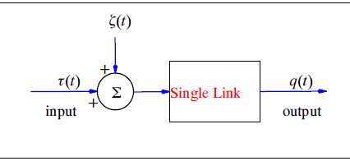
8.3 Independent Joint Control
This term will be treated as an unknown “small” disturbance, and temporarily neglected.
Furthermore, it is simple to scale (8.8) by a, therefore, no loss of generality occurs by letting a = 1. The model thus becomes
(8.9)
By selecting the control law
(8.10)

Slide 11
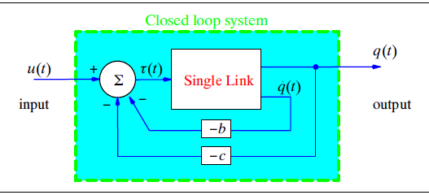

8.3 Independent Joint Control
  and applying this to equation (8.9), the closed loop system becomes
By choice of $α$ and $β$ in (8.10), we can affect the behavior of the closed loop system. Let’s choose $α=−b$ and $β=−c$, which results in
(8.11)
  This first controller of equation (8.10) basically results in a simplified relationship between the input and the output.
Model Based
Control Law

Slide 12
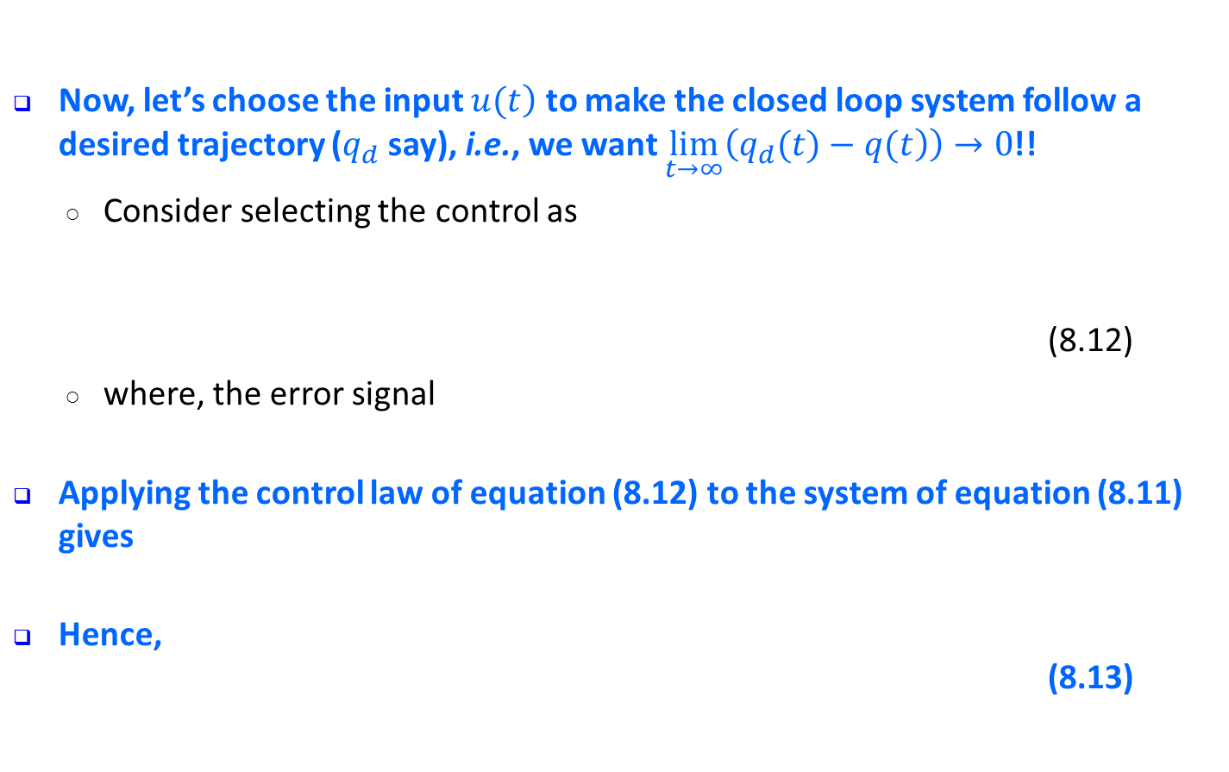
8.3 Independent Joint Control
Now, let’s choose the input $\left.u(t\right)$ to make the closed loop system follow a desired trajectory ($q_{d}$ say), i.e., we want $\lim_{t→∞}\left(\left.q_{d}(t)−q(t\right)\right)→0$!!
  Consider selecting the control as
  (8.12)
  where, the error signal
Applying the control law of equation (8.12) to the system of equation (8.11) gives
Hence,
(8.13)

Slide 13
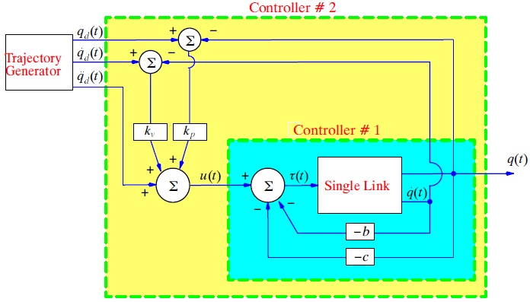

8.3 Independent Joint Control
Given that $e(0)=q_{d}(0)−q(0)$ is typically non-zero (i.e., $e(0)≠0$), by appropriate choice of the scalars $k_{v}$ and $k_{p}$ we can make
fairly quickly
Servo
Control Law

Slide 14
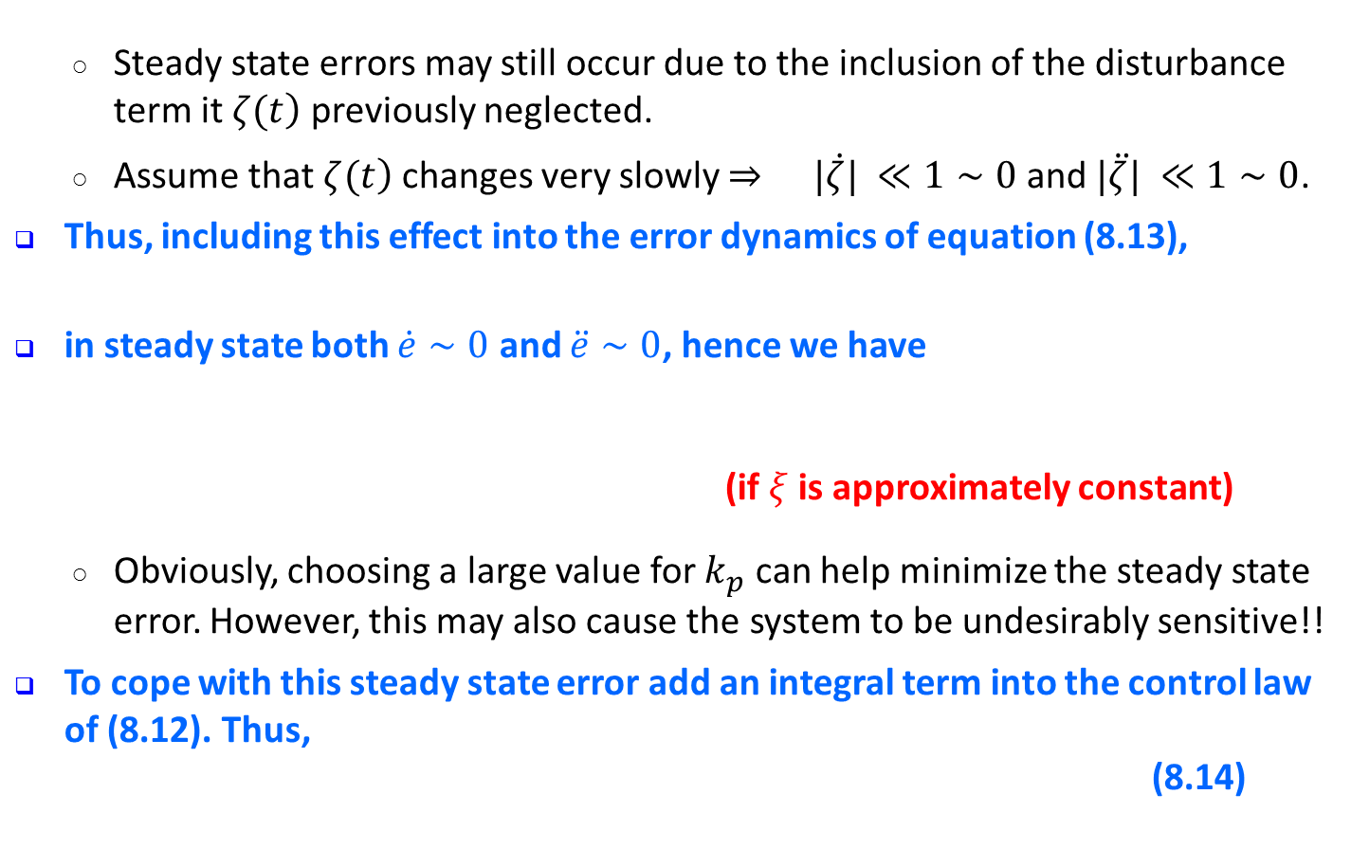
8.3 Independent Joint Control
  Steady state errors may still occur due to the inclusion of the disturbance term it $\left.ζ(t\right)$ previously neglected.
  Assume that $\left.ζ(t\right)$ changes very slowly $⇒ |\dot{ζ}| ≪1∼0$ and $|\ddot{ζ}| ≪1∼0$.
Thus, including this effect into the error dynamics of equation (8.13),
in steady state both $\dot{e}∼0$ and $\ddot{e}∼0$, hence we have
(if $ξ$ is approximately constant)
  Obviously, choosing a large value for $k_{p}$ can help minimize the steady state error. However, this may also cause the system to be undesirably sensitive!!
To cope with this steady state error add an integral term into the control law of (8.12). Thus,
(8.14)

Slide 15
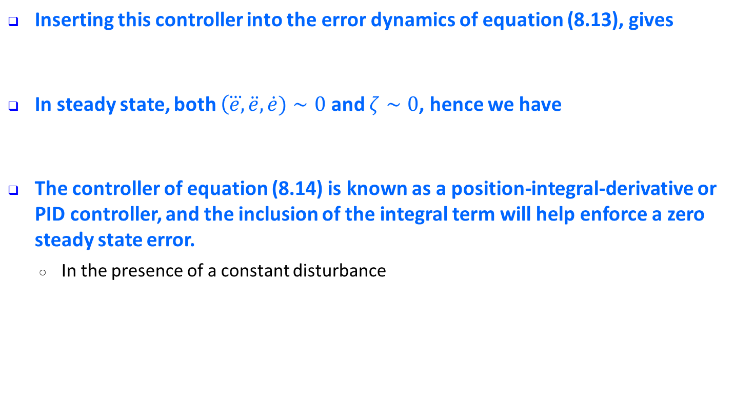
8.3 Independent Joint Control
Inserting this controller into the error dynamics of equation (8.13), gives
In steady state, both $\left(\overset{⃛}{e},\ddot{e},\dot{e})∼0\right.$ and $ζ∼0$, hence we have
The controller of equation (8.14) is known as a position-integral-derivative or PID controller, and the inclusion of the integral term will help enforce a zero steady state error.
  In the presence of a constant disturbance

Slide 16
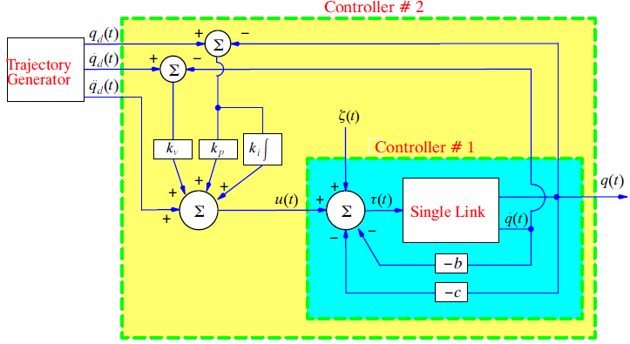
8.3 Independent Joint Control
    We can prove that these types of local control schemes actually do work, at least asymptotically.
    The simplest way to show this is by creating a Lyapunov function using the closed loop system resulting from the two stage control scheme described above.

