Slide 1
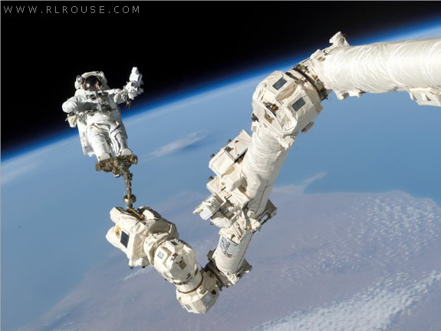
NMT EE 589 & UNM ME 482/582
Robot Engineering
Dr. Stephen Bruder
NMT EE 589 & UNM ME 482/582
Notes:
Presentation slide for courses, classes, lectures et al.

Slide 2
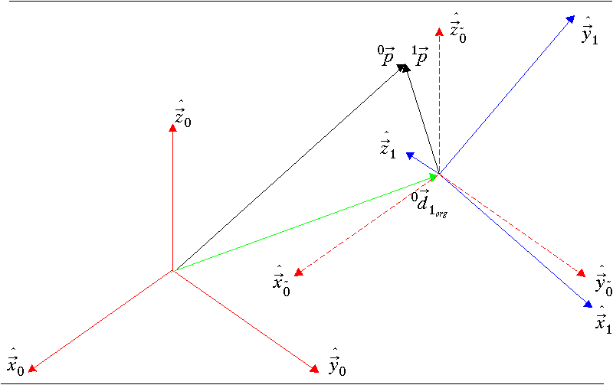

2.4 Position and Orientation Transformations
Changes in both position and orientation together.
Consider the situation in which we are interested in describing a point ‘p’ in coordinate frame {0} (i.e., ${}_{}^{0}{\vec{p}}$ ), given its description as seen from coordinate frame {1} (i.e., ${}_{}^{1}{\vec{p}}$).

Slide 3
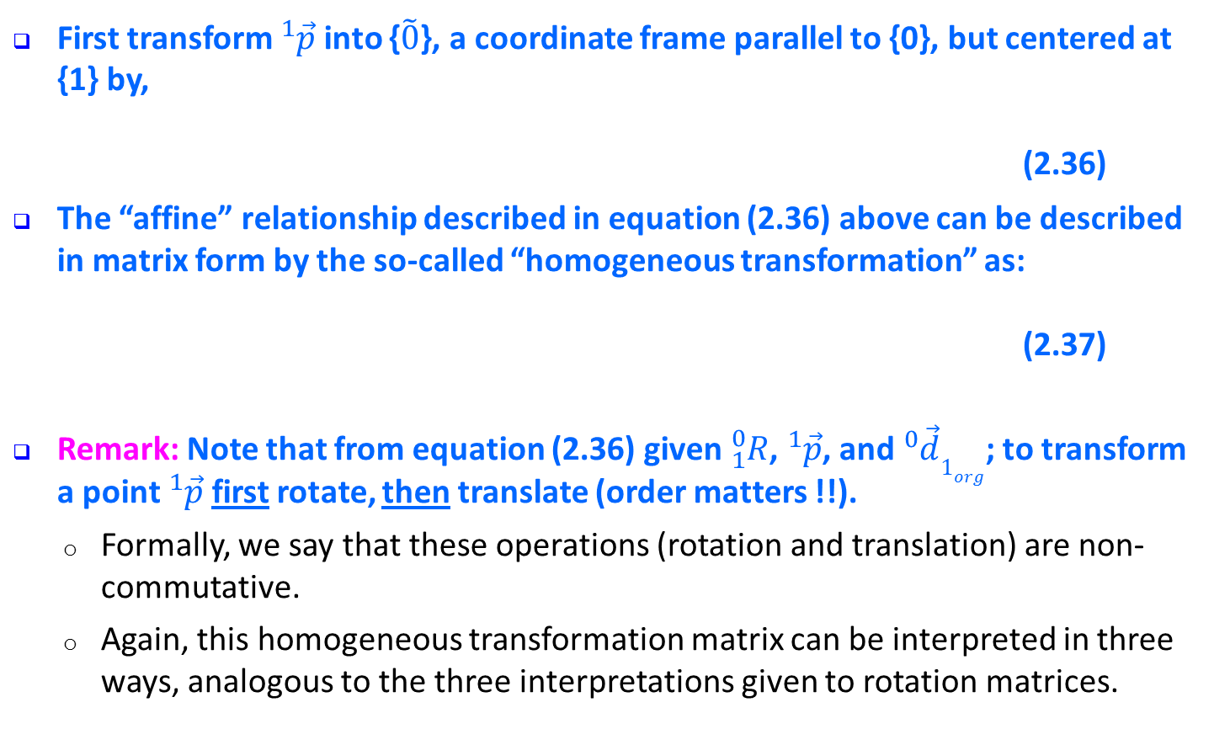
2.4 Position and Orientation Transformations
First transform ${}_{}^{1}{\vec{p}}$ into {$\tilde{0}$}, a coordinate frame parallel to {0}, but centered at {1} by,
(2.36)
The “affine” relationship described in equation (2.36) above can be described in matrix form by the so-called “homogeneous transformation” as:
(2.37)
Remark: Note that from equation (2.36) given ${}_{1}^{0}R$, ${}_{}^{1}{\vec{p}}$, and ${}_{}^{0}{\vec{d}1_{org}}$; to transform a point ${}_{}^{1}{\vec{p}}$ first rotate, then translate (order matters !!).
  Formally, we say that these operations (rotation and translation) are non-commutative.
  Again, this homogeneous transformation matrix can be interpreted in three ways, analogous to the three interpretations given to rotation matrices.

Slide 4
2.4 Position and Orientation Transformations
Question:
  Is there an “easy” way to invert a homogeneous transform?
Answer:
  Consider the following (recall Eqn. 2.37):
  (2.38)
  (2.39)

Slide 5
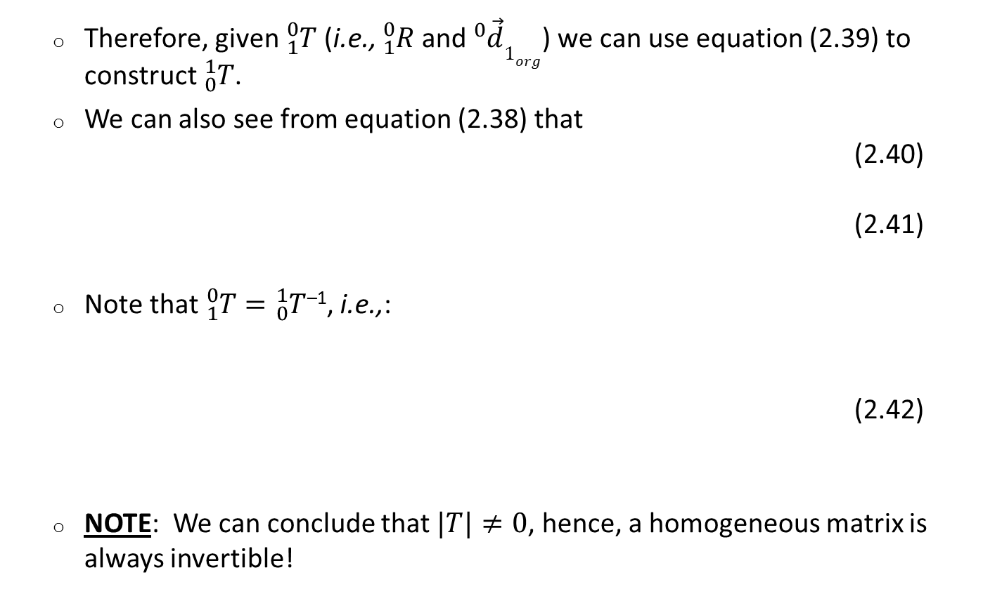
2.4 Position and Orientation Transformations
  Therefore, given ${}_{1}^{0}T$ (i.e., ${}_{1}^{0}R$ and ${}_{}^{0}{\vec{d}1_{org}}$) we can use equation (2.39) to construct ${}_{0}^{1}T$.
  We can also see from equation (2.38) that
  (2.40)
  (2.41)
  Note that ${}_{1}^{0}T={}_{0}^{1}T$^{–1}, i.e.,:
  (2.42)
  NOTE: We can conclude that $|T|≠0$, hence, a homogeneous matrix is always invertible!

Slide 6
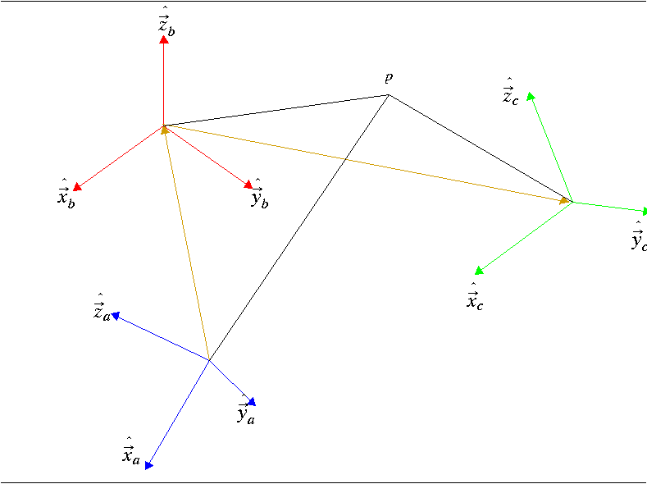

2.4.1 Compounding Transformations
Knowing the description of coordinate frame {c} in coordinate frame {b} and the location of the point ‘p’ in {c}, it is possible to transform ${}_{}^{c}{\vec{p}}$ to ${}_{}^{b}{\vec{p}}$ by (neglecting the vectors ${}_{}^{c}{\vec{p}}$ and ${}_{}^{b}{\vec{p}}$ for notational clarity).
Similarly we can now
further transform the
description into
coordinate frame {a}
using

Slide 7
2.4.1 Compounding Transformations
Thus,
(2.43)
Remark: These homogeneous transformations are very useful in computer graphics for transforming image points.

Slide 8
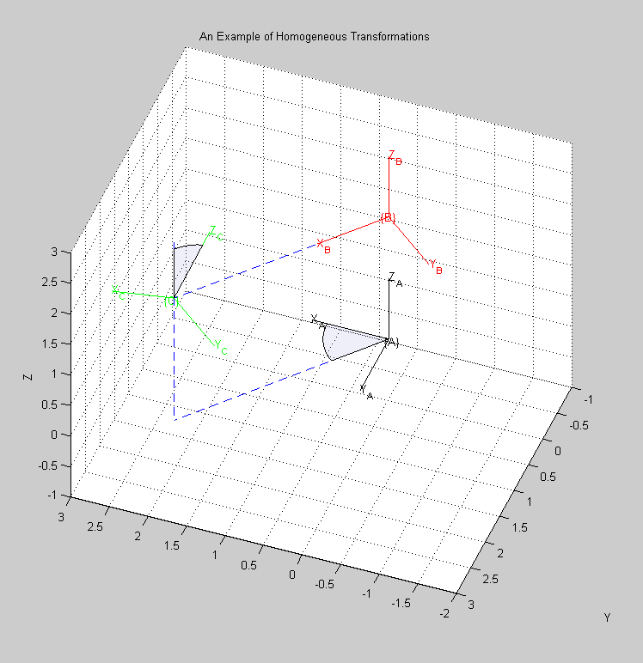

2.4.1 Compounding Transformations
An Example:
  What is ${}_{B}^{A}T$?
30°
2
50°
3

Slide 9

2.4.1 Compounding Transformations
An Example:
  What is ${}_{B}^{A}T$?
  What is ${}_{C}^{B}T$?
30°
2
50°
3

Slide 10

2.4.1 Compounding Transformations
Example 1:
  What is ${}_{C}^{A}T$?
30°
2
50°
3
Alternatively,
homo_example1.m

Slide 11

2.4.1 Compounding Transformations
Example 2: Similar to 2.2 from Craig (page 29)
  Frame {B} is rotated 30° about z_{A}, translated 4 units along x_{A} , 3units along y_{A}, and 2 units along z_{A}.
  Hence:
  Given ${}_{}^{B}P=\left[\begin{matrix}−2 \\ −1 \\ 1\end{matrix}\right]$ find ${}_{}^{A}P$
homo_example2.m

Slide 12
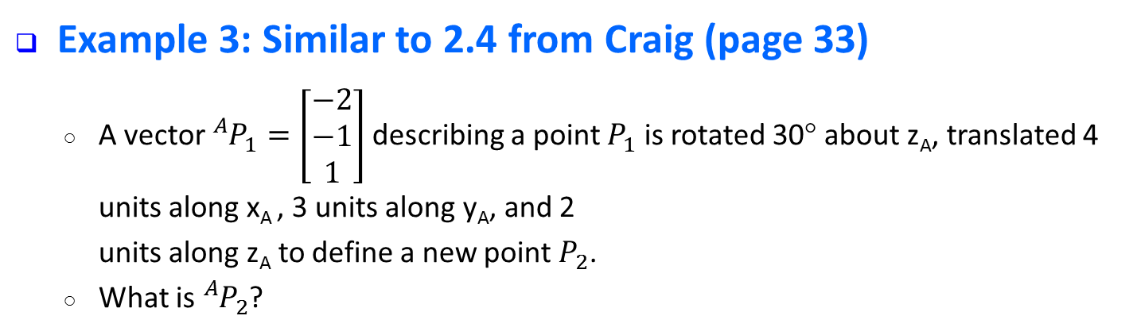
2.4.1 Compounding Transformations
Example 3: Similar to 2.4 from Craig (page 33)
  A vector ${}_{}^{A}{P_{1}^{}}=\left[\begin{matrix}−2 \\ −1 \\ 1\end{matrix}\right]$ describing a point $P_{1}^{}$ is rotated 30° about z_{A}, translated 4 units along x_{A} , 3 units along y_{A}, and 2
  units along z_{A} to define a new point $P_{2}^{}$.
  What is ${}_{}^{A}{P_{2}^{}}$?
homo_example3.m

