Slide 1
NMT EE 589 & UNM ME 482/582 Robot Engineering
Dr. Stephen Bruder NMT EE 589 & UNM ME 482/582
Notes:
Presentation slide for courses, classes, lectures et al.

Slide 2
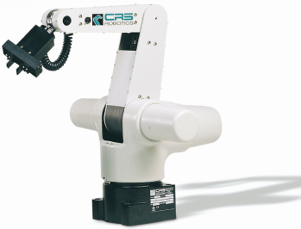
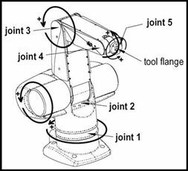
An In Class Example
Consider the CRS A255 Robot (brochure)
A 5 DOF “RRRRR” Anthropomorphic Robotic Arm

Slide 3
Forward Kinematics
Step 1: Identify the Joint Axes
Axis #1
Axis #3
Axis #4
Axis #5
Axis #2

Slide 4
Forward Kinematics
Step 2: Assign link origns
Axis #1
origin of frames {4 & 5}
Axis #3
origin of frame{3}
Axis #4
Axis #5
origin of frame{2}
Axis #2
origin of frame{1}

Slide 5
Forward Kinematics
Step 3: Assign z-axes
Axis #1
z₃
Axis #3
z₄
z₅
Axis #4
z₁
Axis #5
z₂
Axis #2

Slide 6
Forward Kinematics
Step 4: Assign x-axes
Axis #1
z₃
x₃
x_{4,5}
Axis #3
z₄
z₅
Axis #4
z₁
Axis #5
x₂
z₂
x₁
Axis #2

Slide 7
Forward Kinematics
Step 6: Add a base/Tool Frame
Axis #1
z₃
x₃
x_{4,5}
Axis #3
z₄
z₅
Axis #4
z₁
Axis #5
x₂
z₂
x₁
Axis #2
z₀
x₀

Slide 8
Forward Kinematics
Build DH Table
D-H params. i |  |  | $${\text{d}}_{\text{i}}$$
1
2
3
4
5
z₃
x₃
x_{4,5}
z₄
z₅
x₂
z₁
z₂
x₁
From measurements:
d₁=10 in
a₂=10 in
a₃=10 in
z₀
x₀

Slide 9
Forward Kinematics
A quick visual check of the D-H table via Robotics TB
z₃
x₃
x_{4,5}
z₄
z₅
x₂
z₁
z₂
x₁
z₀
x₀

Slide 10
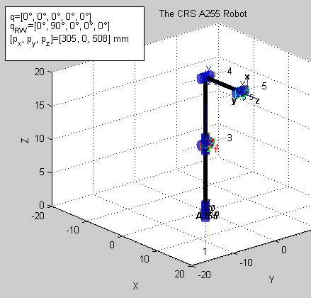
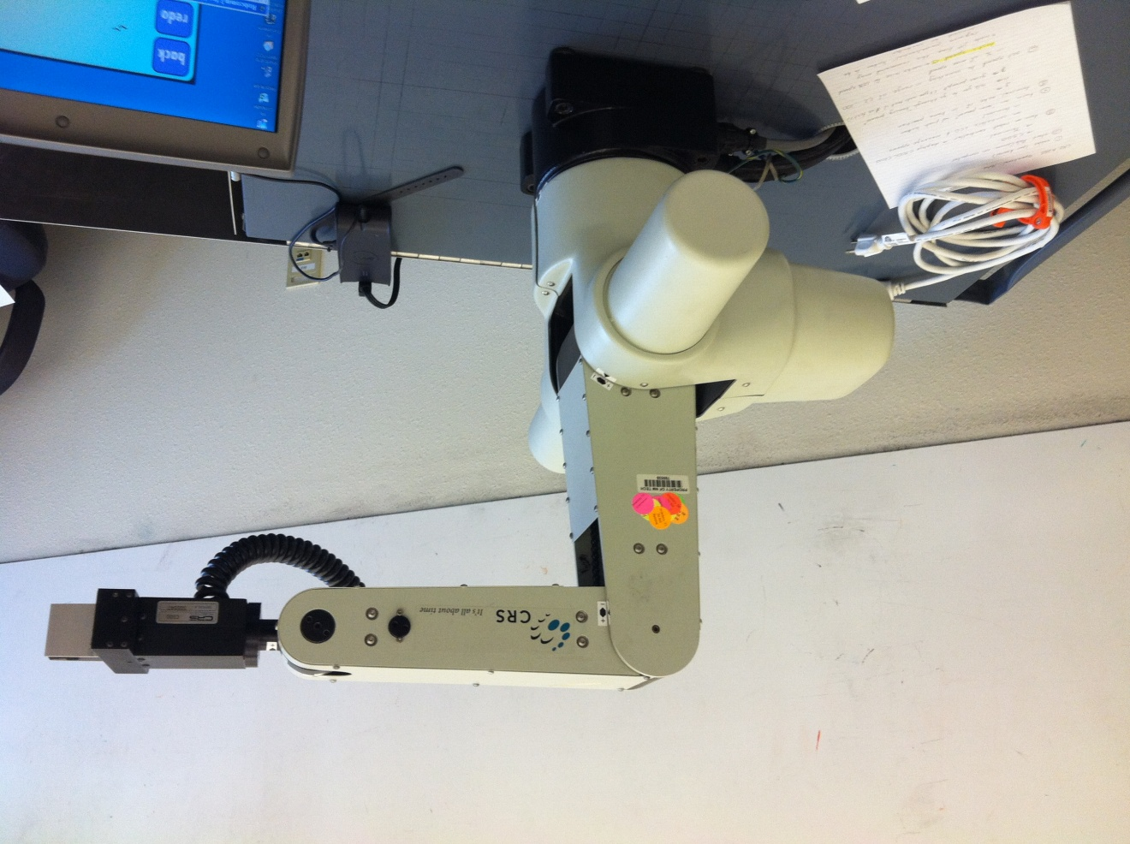
Forward Kinematics
Real World vs Model

Slide 11
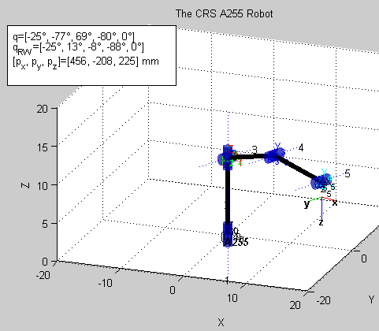
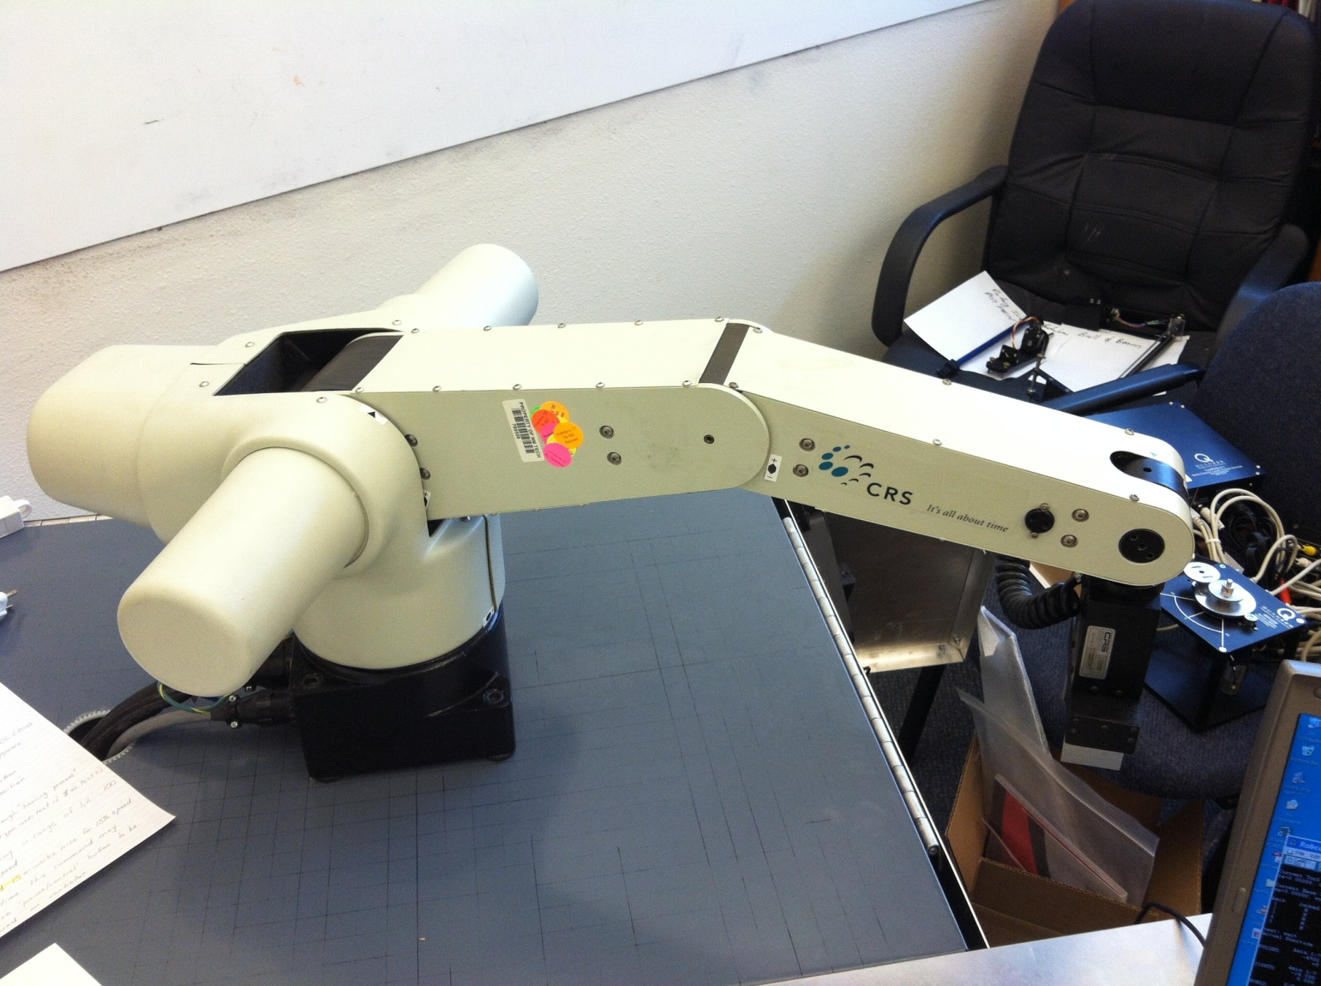
Forward Kinematics
Real World vs Model
Config#2

Slide 12
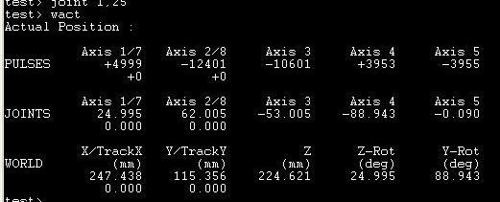
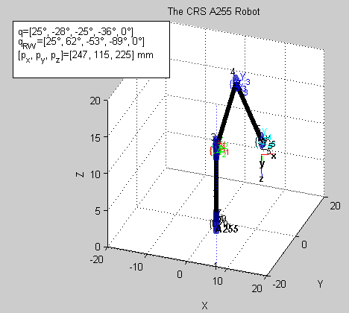
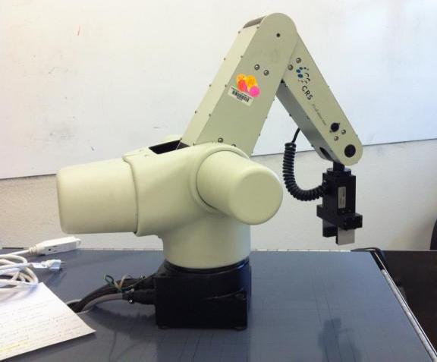
Forward Kinematics
Real World vs Model
Config#3

Slide 13
Forward Kinematics
Build the T-matrices

Slide 14
Inverse Kinematics
A 6 DOF World and a 5 DOF Robot?
Looking at the A255 robot it seems reasonable to solve for the 3D position, inclination of z₅ to the x/y plane, and rotation about axis#5 (screwdriver type applications).
Considering the positional equations

Slide 15
Inverse Kinematics
From (1.1) and (1.2) we get
Hence,

Slide 16
Inverse Kinematics
{3}
Looking at the length of {1} to {5}
This should only be a fn of θ₃
{4}
{5}
{1}
{2}
{0}

Slide 17
Inverse Kinematics
Adding Eqn. (1.2) × Cos(θ₂) to Eqn. (1.3) × Sin(θ₂)
This is case 7, hence

Slide 18
Inverse Kinematics
Finally, inclination of z₅ to the x/y plane
And, θ₅ is given
The X₀/Y₀ plane

Slide 19
Motion Kinematics
Build the Jacobian Matrix
Let’s use the indirect method to build J_{v}

Slide 20
Motion Kinematics
Build the Jacobian Matrix
Let’s use the direct method to build J_{ω}
Hence,

